Slide 1
Leap year or not
In the Gregorian calendar, a normal year consists of 365 days. Because the actual length of a sidereal year (the time required for the Earth to revolve once about the Sun) is actually 365.2425 days, a "leap year" of 366 days is used once every four years to eliminate the error caused by three normal (but short) years. Any year that is evenly divisible by 4 is a leap year: for example, 1988, 1992, and 1996 are leap years.
However, there is still a small error that must be accounted for. To eliminate this error, the Gregorian calendar stipulates that a year that is evenly divisible by 100 (for example, 1900) is a leap year only if it is also evenly divisible by 400.
For this reason, the following years are not leap years:
1700, 1800, 1900, 2100, 2200, 2300, 2500, 2600
This is because they are evenly divisible by 100 but not by 400.
The following years are leap years: 1600, 2000, 2400
This is because they are evenly divisible by both 100 and 400.
=IF(OR(MOD(A1,400)=0,AND(MOD(A1,4)=0,MOD(A1,100)<>0)),"Leap Year", "NOT a Leap Year")

Slide 2
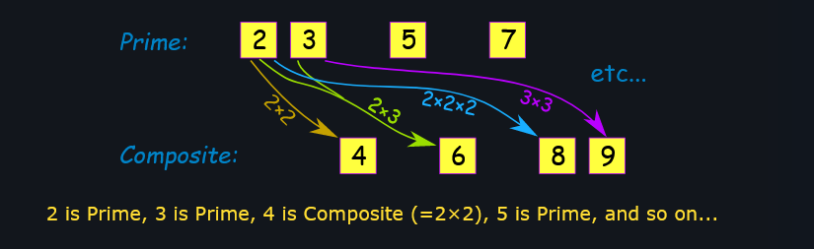
Prime number
a whole number above 1 that cannot be made by multiplying other whole numbers

Slide 3
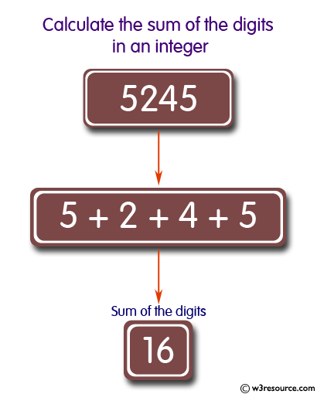
Sum of digits of number
We can calculate the sum of digits of a number by adding a number's digits while ignoring the place values. So, if we have the number 567, we can calculate the digit sum as 5 + 6 + 7, which equals 18

Slide 4
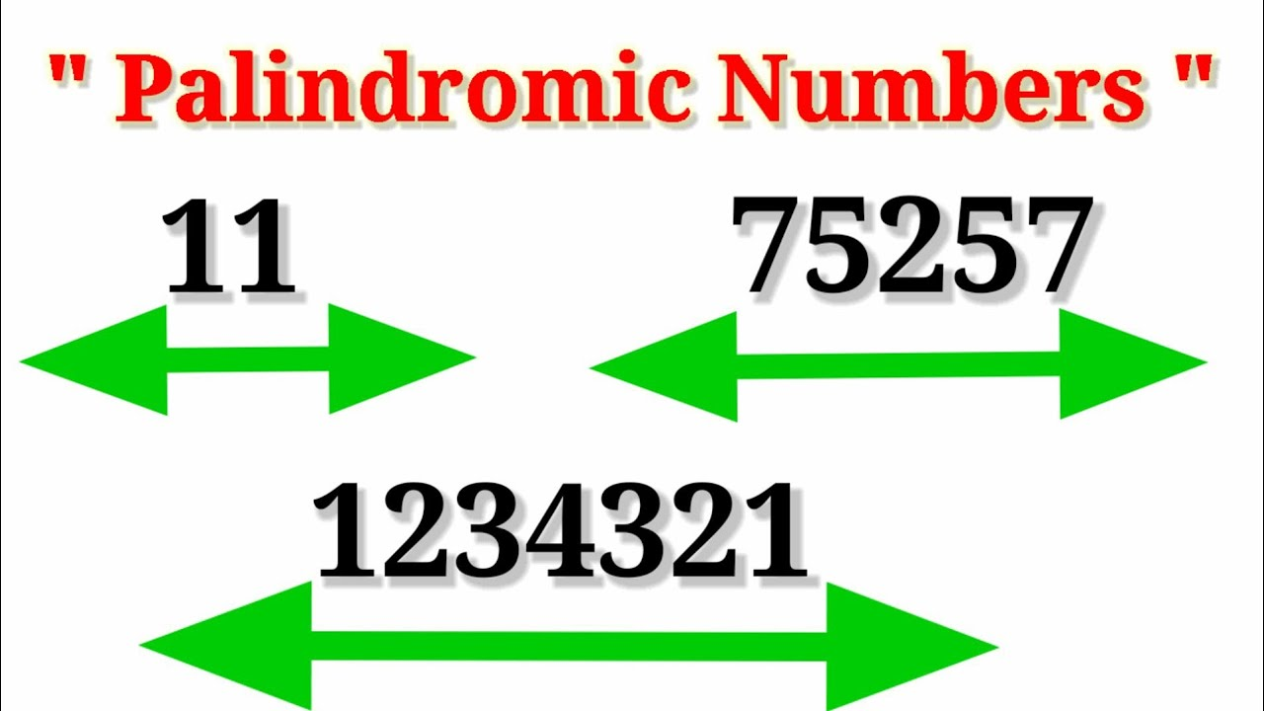
Palindrome number
A palindromic number (also known as a numeral palindrome or a numeric palindrome) is a number (such as 16461) that remains the same when its digits are reversed. In other words, it has reflectional symmetry across a vertical axis.

Slide 5
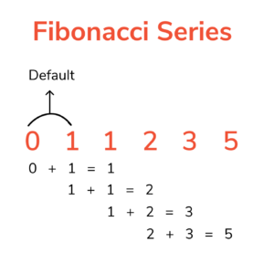
Fibonacci series of nth term
The Fibonacci series is an infinite series, starting from '0' and '1', in which every number in the series is the sum of two numbers preceding it in the series.

Slide 6
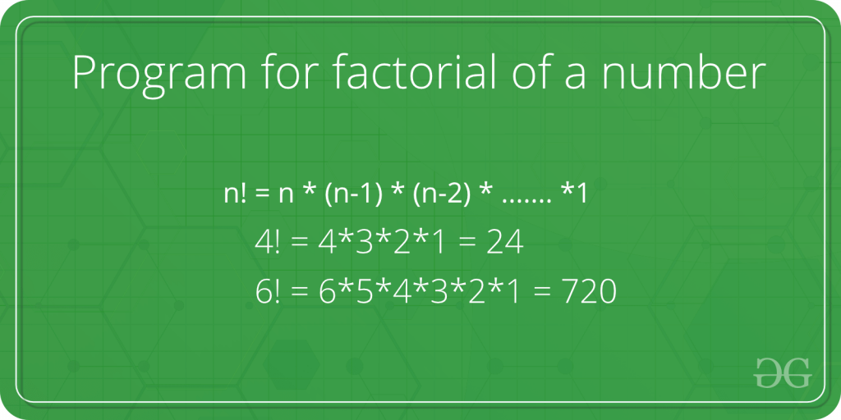
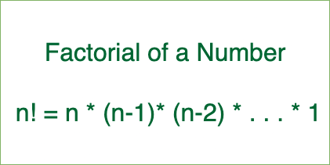
Factorial of a number
Factorial of a positive integer (number) is the sum of multiplication of all the integers smaller than that positive integer. For example, factorial of 5 is 5 * 4 * 3 * 2 * 1 which equals to 120. Factorial Program in C: All positive descending integers are added together to determine the factor of n.

Slide 7
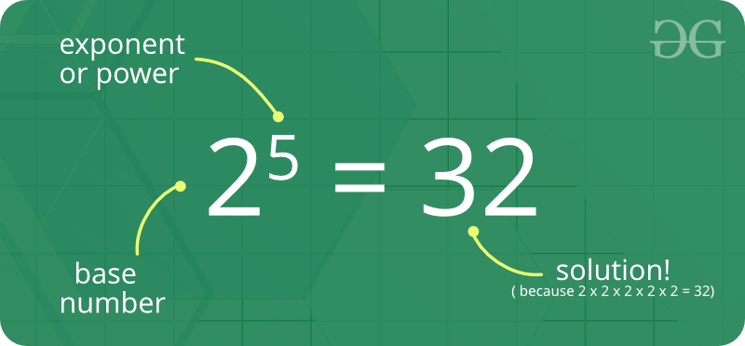
Power of a number
The power of a number says how many times to use the number in a multiplication. Powers are also called Exponents or Indices.

Slide 8
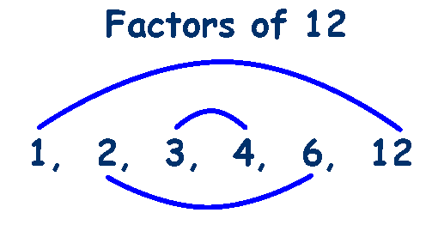
Factor of a number
factor, in mathematics, a number or algebraic expression that divides another number or expression evenly—i.e., with no remainder. For example, 3 and 6 are factors of 12 because 12 ÷ 3 = 4 exactly and 12 ÷ 6 = 2 exactly. The other factors of 12 are 1, 2, 4, and 12.

Slide 9
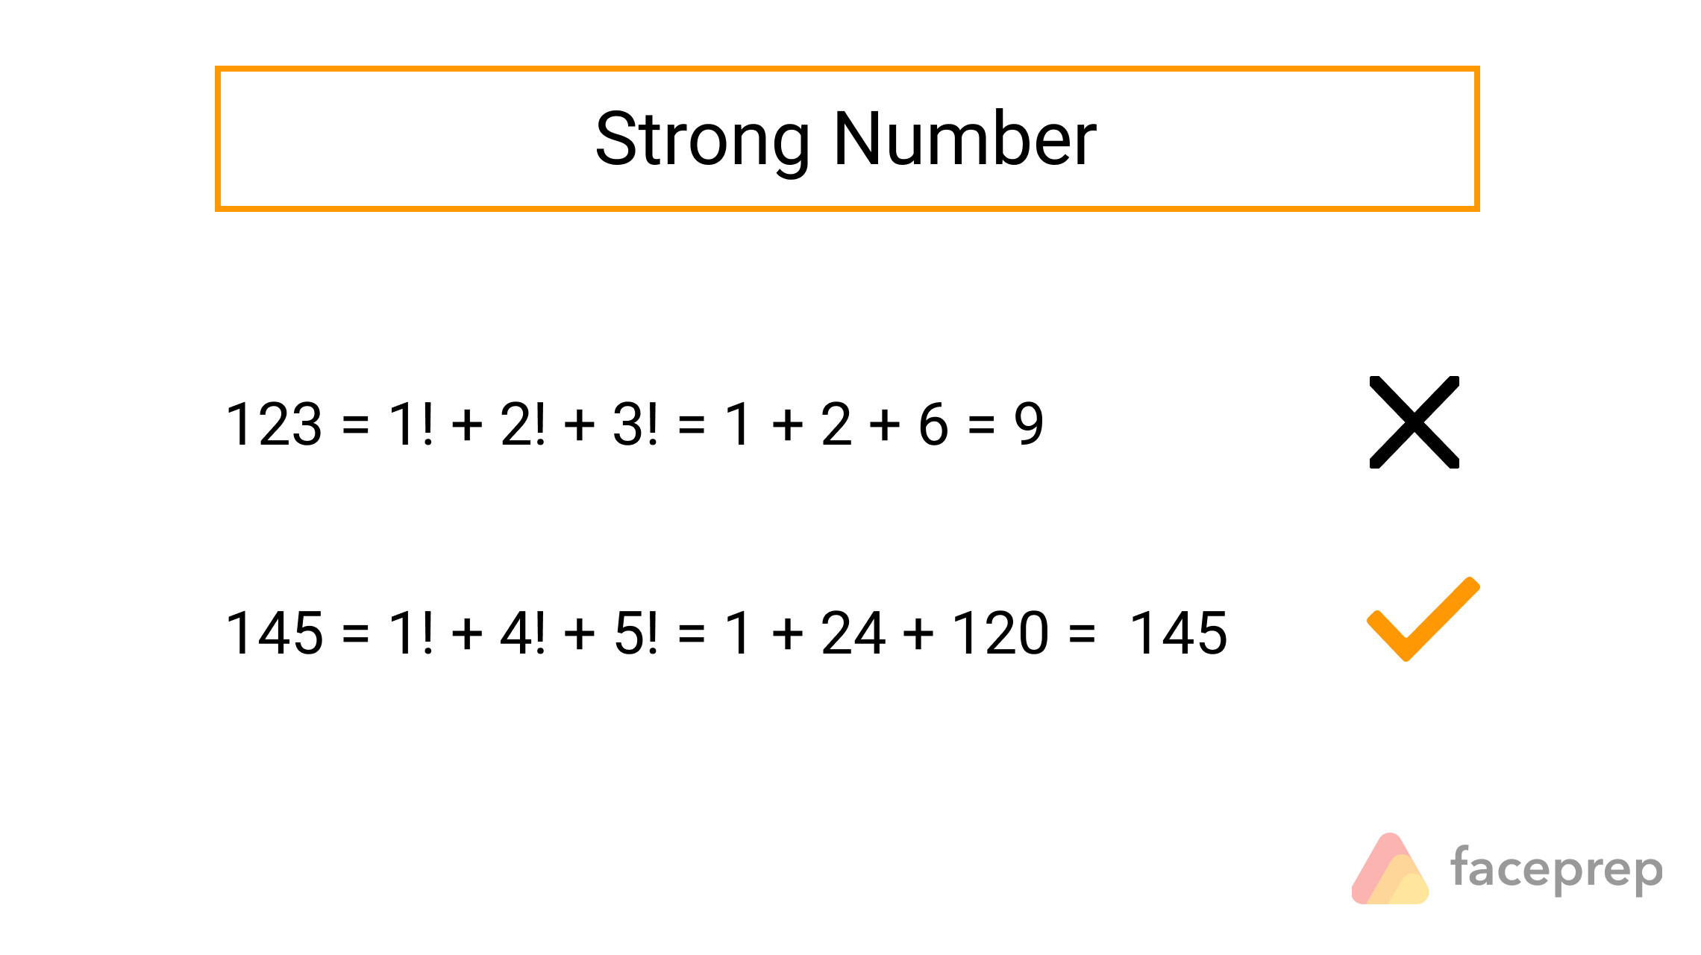
Strong Number
Strong number is a special number whose sum of the factorial of digits is equal to the original number. For Example: 145 is strong number. Since, 1! + 4! + 5!

Slide 10
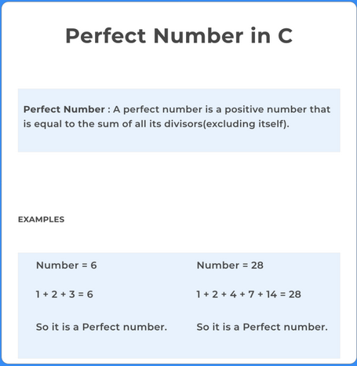
Perfect Number
perfect number, a positive integer that is equal to the sum of its proper divisors. The smallest perfect number is 6, which is the sum of 1, 2, and 3. Other perfect numbers are 28, 496, and 8,128

Slide 11
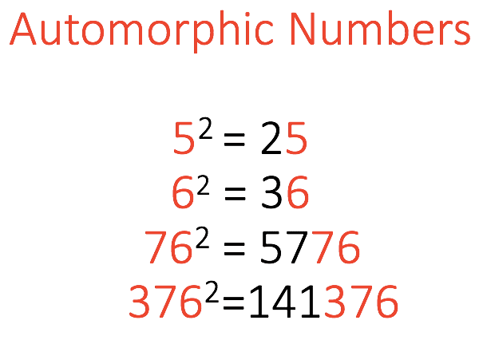
Automorphic Number
A number is called an Automorphic number if and only if its square ends in the same digits as the number itself. Examples : Input : N = 76

Slide 12
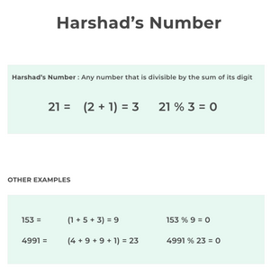
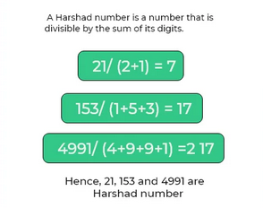
Harshad Number
In mathematics, a harshad number (or Niven number) in a given number base is an integer that is divisible by the sum of its digits when written in that base. Harshad numbers in base n are also known as n-harshad (or n-Niven) numbers.

Slide 13
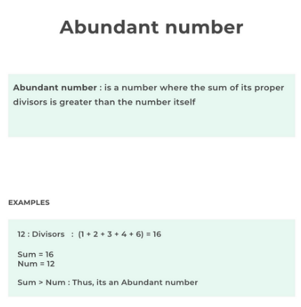
. Abundant Number
In number theory, an abundant number or excessive number is a positive integer for which the sum of its proper divisors is greater than the number.
Examples. The first 28 abundant numbers are: 12, 18, 20, 24, 30, 36, 40, 42, 48, 54, 56, 60, 66, 70, 72, 78, 80, 84, 88, 90, 96, 100, 102, 104, 108, 112, 114, 120

Slide 14
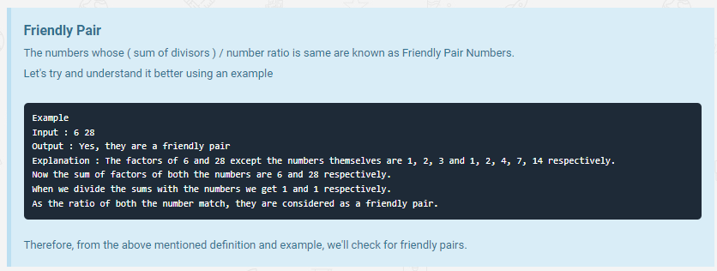
Friendly Pair

Slide 15
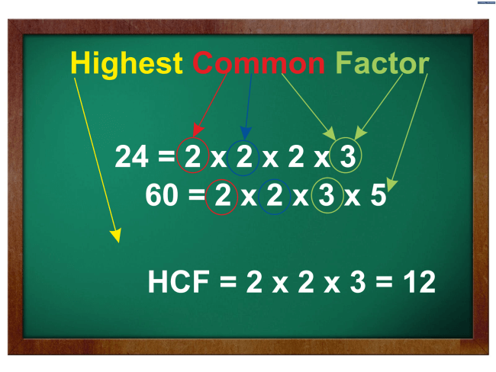
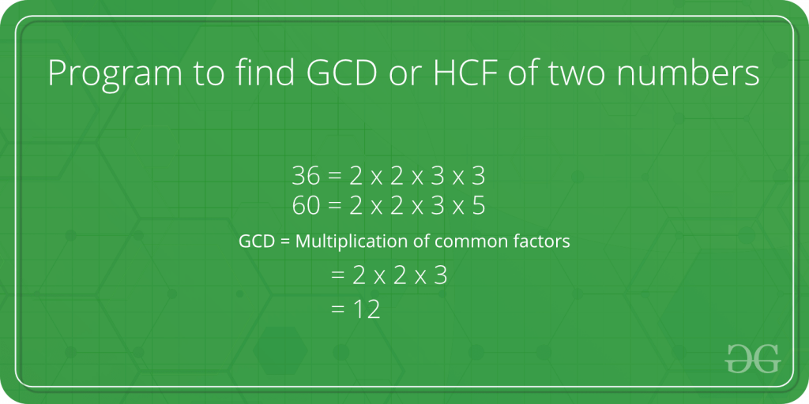
HCF
What is HCF? The full form of HCF is Highest Common Factor. HCF of two numbers is the highest factor that can divide the two numbers, evenly. HCF can be evaluated for two or more than two numbers. It is the greatest divisor for any two or more numbers, that can equally or completely divide the given numbers.

Slide 16
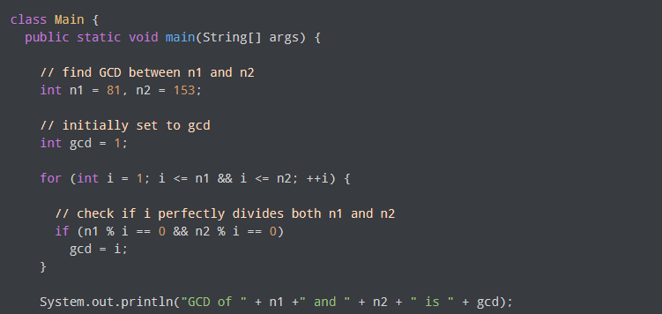

Slide 17
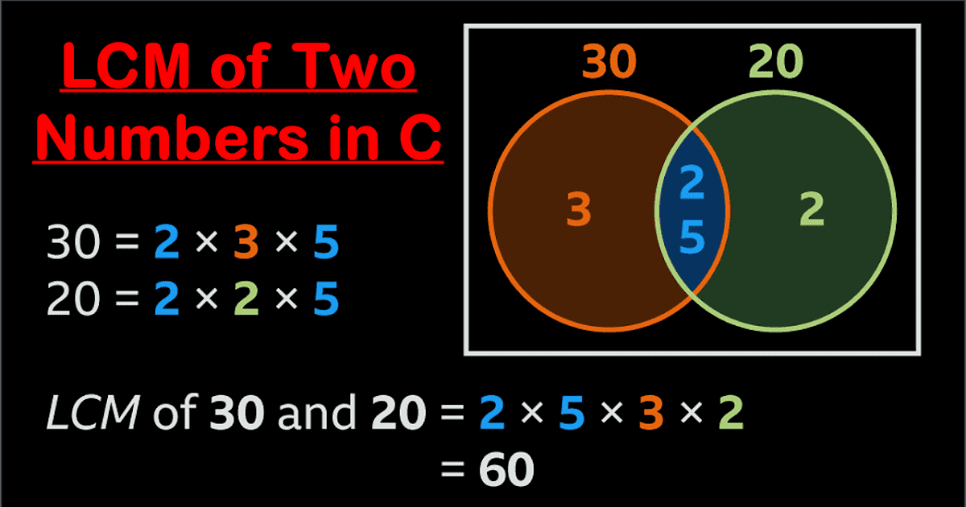
LCM
In Mathematics, the LCM of any two is the value that is evenly divisible by the two given numbers. The full form of LCM is Least Common Multiple. It is also called the Least Common Divisor (LCD). For example, LCM (4, 5) = 20. Here, the LCM 20 is divisible by both 4 and 5 such that 4 and 5 are called the divisors of 20.

Slide 18
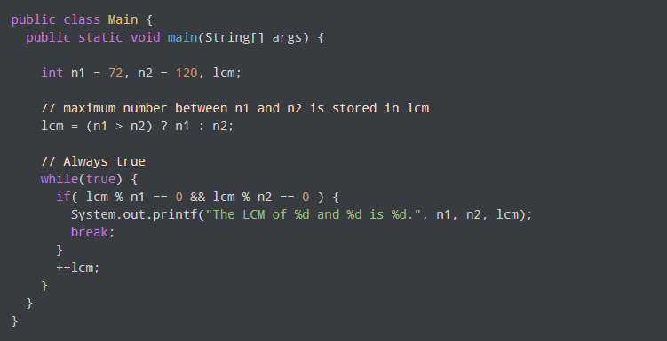

Slide 19
Greatest Common Divisor
In mathematics, the greatest common divisor (GCD) of two or more integers, which are not all zero, is the largest positive integer that divides each of the integers.
For two integers x, y, the greatest common divisor of x and y is denoted gcd ( x , y ).
For example, the GCD of 8 and 12 is 4, that is, gcd ( 8 , 12 ) = 4 gcd(8,12)=4

Slide 20
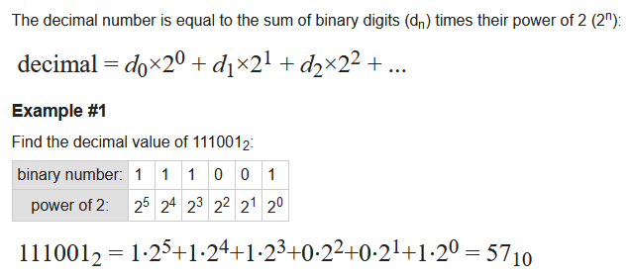
Binary to decimal conversion

Slide 21
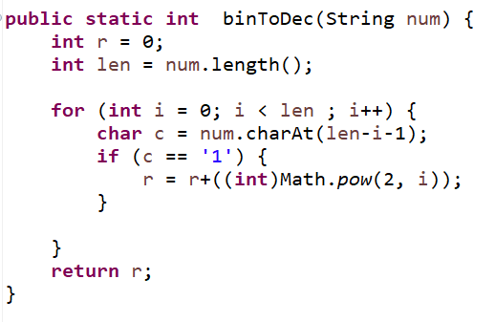

Slide 22
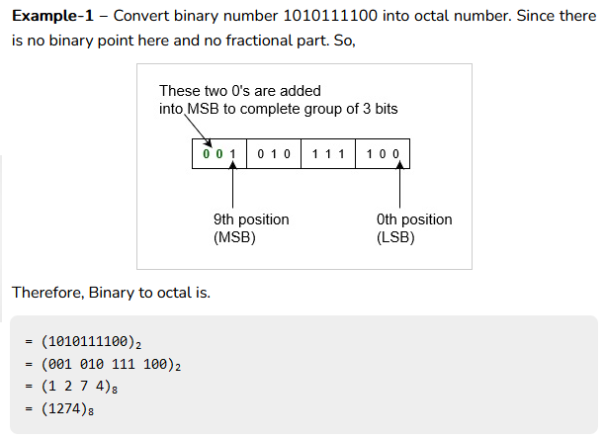
Binary to octal conversion

Slide 23
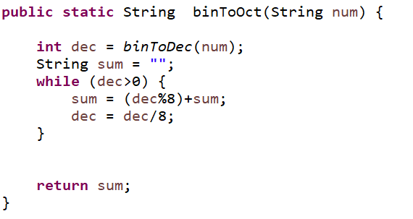

Slide 24
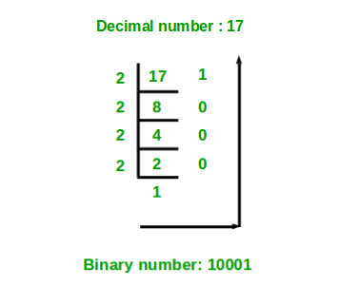
Decimal to binary conversion

Slide 25
Decimal to binary conversion
public static String DecToBin(int num){
String sum = "";
while (num>0) {
sum = num%2 + sum;
num = num/2;
}
return sum;
}

Slide 26
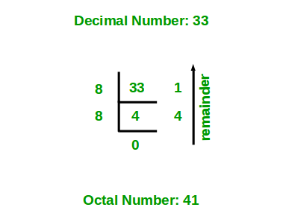
Decimal to octal conversion

Slide 27
Decimal to octal conversion
public static String DecToOct(int num){
String sum = "";
while (num>0) {
sum = num%8 + sum;
num = num/8;
}
return sum;
}

Slide 28
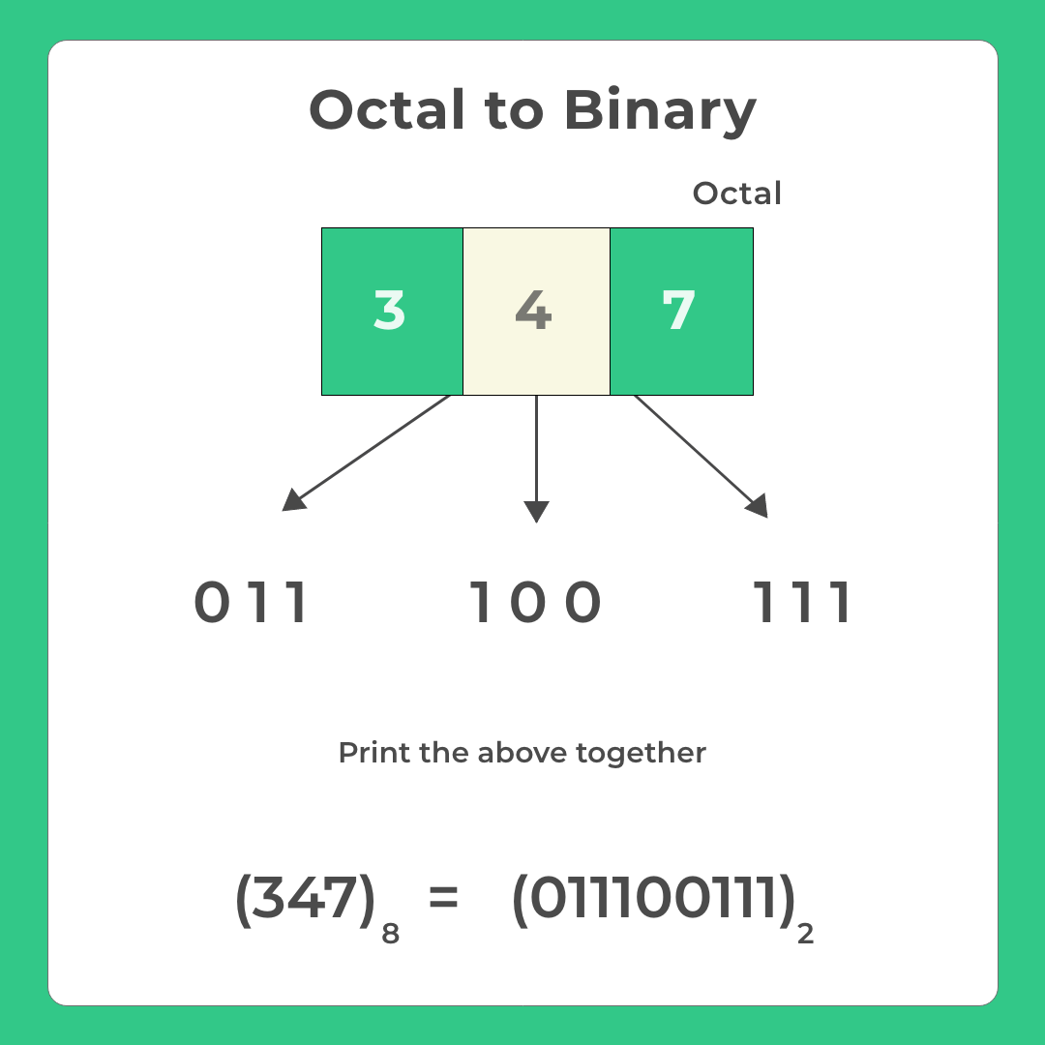
Octal to Binary conversion

Slide 29
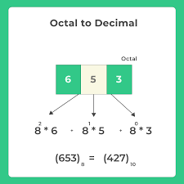
Octal to Decimal Conversion

Slide 30
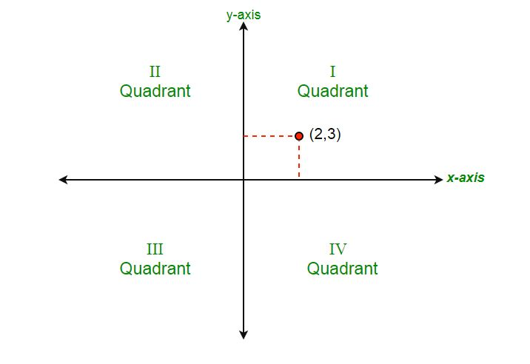
Quadrants in which given coordinate lies

Slide 31
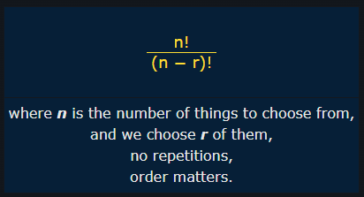
Permutations in which n people can occupy r seats in a classroom

Slide 32
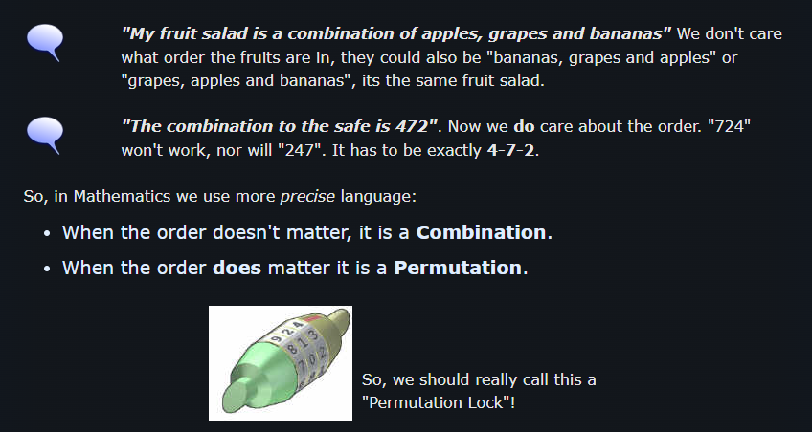
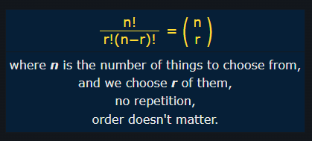
Combination

Slide 33
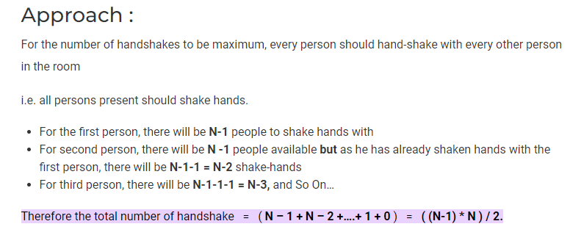
Maximum number handshakes

Slide 34
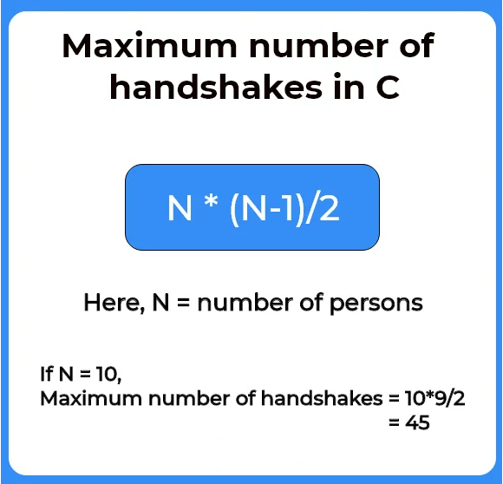

Slide 35
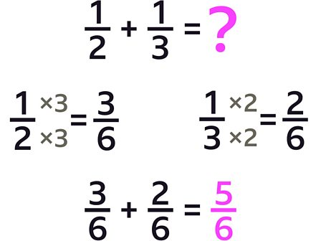
Addition of two fractions

Slide 36
class addFractions {
public static void main(String[] args) {
// initialise numerator of first fraction
int numerator1 = 2;
// initialise numerator of second fraction
int denominator1 = 3;
// initialise numerator of second fraction
int numerator2 = 4;
// initialise denominator of second fraction
int denominator2 = 5;
// use the cross multiplication rule
int numerator3 = numerator1 * denominator2 + numerator2 * denominator1;
// find lcm
int denominator3 = denominator1 * denominator2;
// print the results.
System.out.println(numerator3 + "/" + denominator3);
}
}

Slide 37
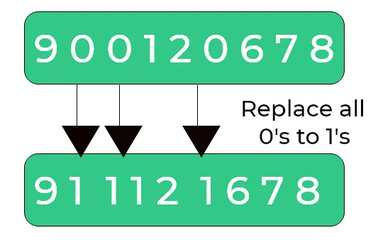
Replace all 0’s with 1 in a given integer

Slide 38
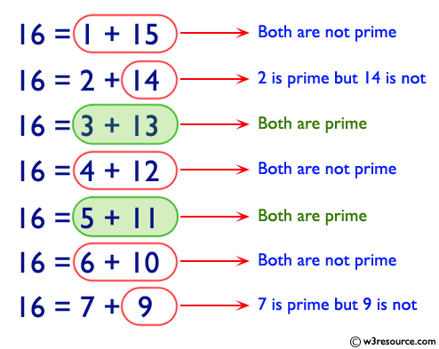
can a number be expressed as a sum of two prime numbers

Slide 39
Count possible decodings of a given digit sequence

